Slide 1
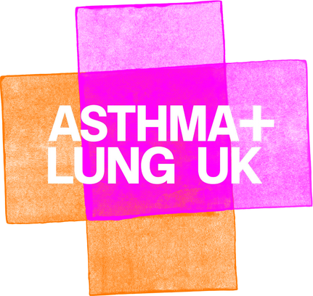


Slide 2


In this lesson, we'll be...
• learning about what our lungs do.
• learning about things that can cause harm to our lungs.
• learning about ways to look after our lungs.
• using special vocabulary.
Keywords
respiratory system
lungs
capacity
diaphragm
ribcage
blood
breathing
mucus
inhale and exhale
air
oxygen
carbon dioxide
gas exchange
health and wellbeing
exercise
pollution
harmful substances

Slide 3
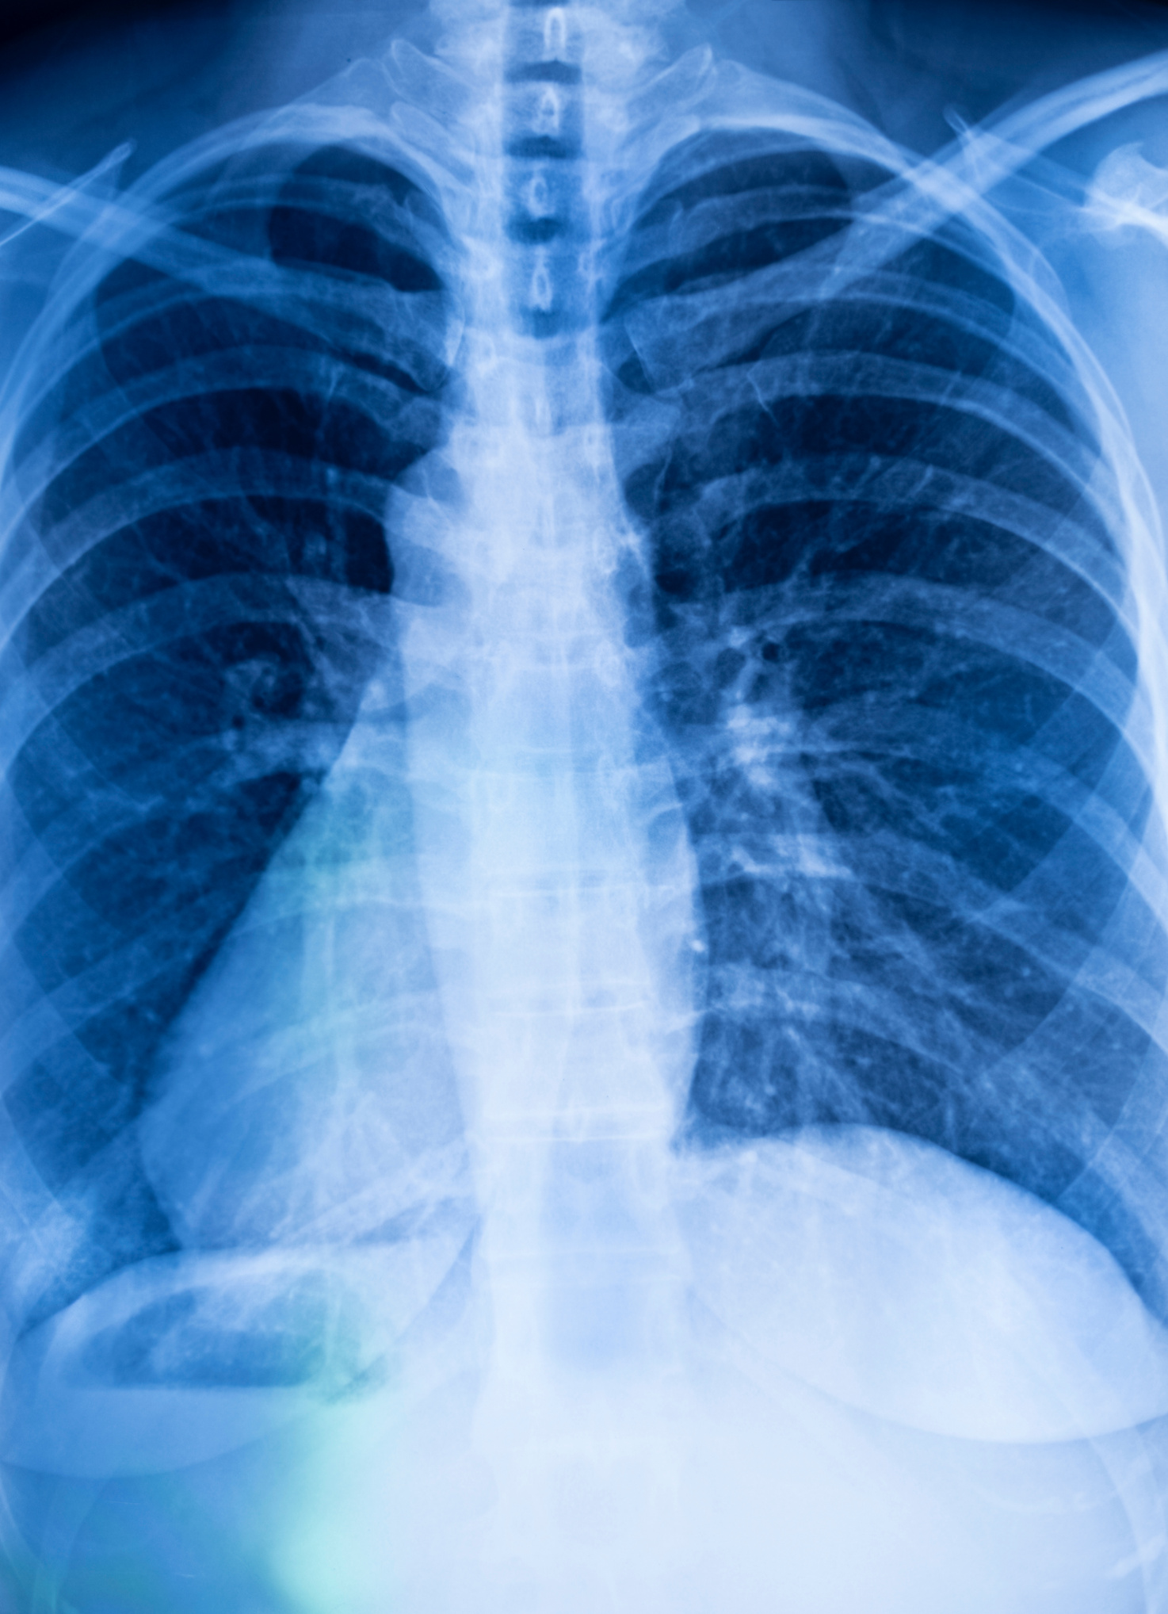
Take a deep breath
Take a breath in now, then breathe out slowly.
Air travels from our nose and mouth through tubes to the lungs.
When we breathe in, a muscle called the diaphragm moves down. This makes space for our two lungs to fill up with air.
The lungs are in our chest and are protected by our ribcage. While we're sitting quietly, we're using less than half of our lung capacity.
What makes our breathing faster and our lungs increase?

Slide 4

Growing lungs
Age | Breaths per minute
1 to 3 years | 24 to 40
3 to 5 years | 22 to 34
5 to 12 years | 16 to 30
12 to 18 years | 12 to 20
A baby's lungs start to grow when they are in the womb. The lungs grow like branches on a tree – out to the left and the right.
Your lungs are still growing, like other body parts.
And because your lungs are smaller than adult lungs, you breathe faster.
How many breaths do you think you take in one minute?
You can count your breaths in one minute now.

Slide 5
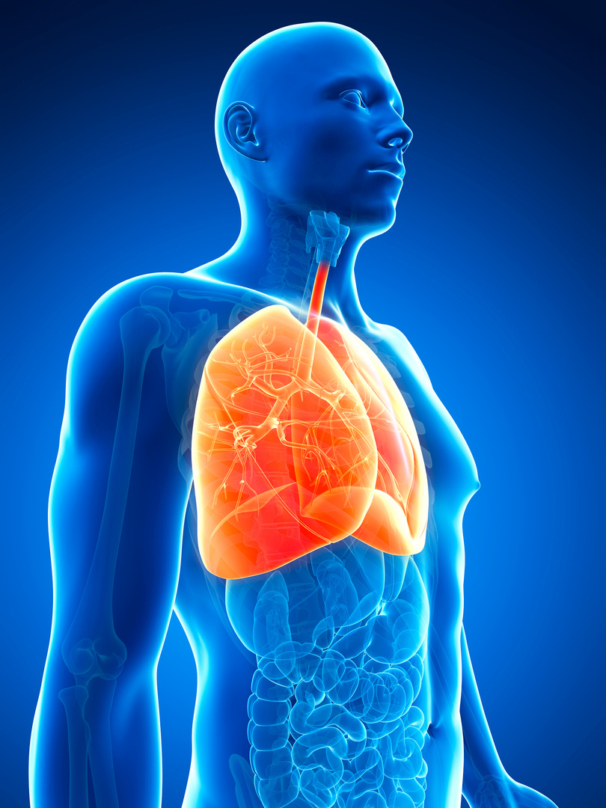
How the lungs work
Our lungs are part of our respiratory system. They have a very important job to do!
When we inhale, we're taking air into our lungs. Air is 21% oxygen. The oxygen we inhale moves to our blood and is transported all around our bodies.
Carbon dioxide, a waste gas, moves from our blood to our lungs and is exhaled.
This process, called gas exchange, is essential to life.

Slide 6


Watch them work
The lungs are like bags that fill with air, then empty.
We can see how the lungs work by creating a simple model.
For this model, you will need:
•An empty hard plastic bottle (500-600ml)
•Two biodegradable balloons
•Scissors & craft knife

Slide 7
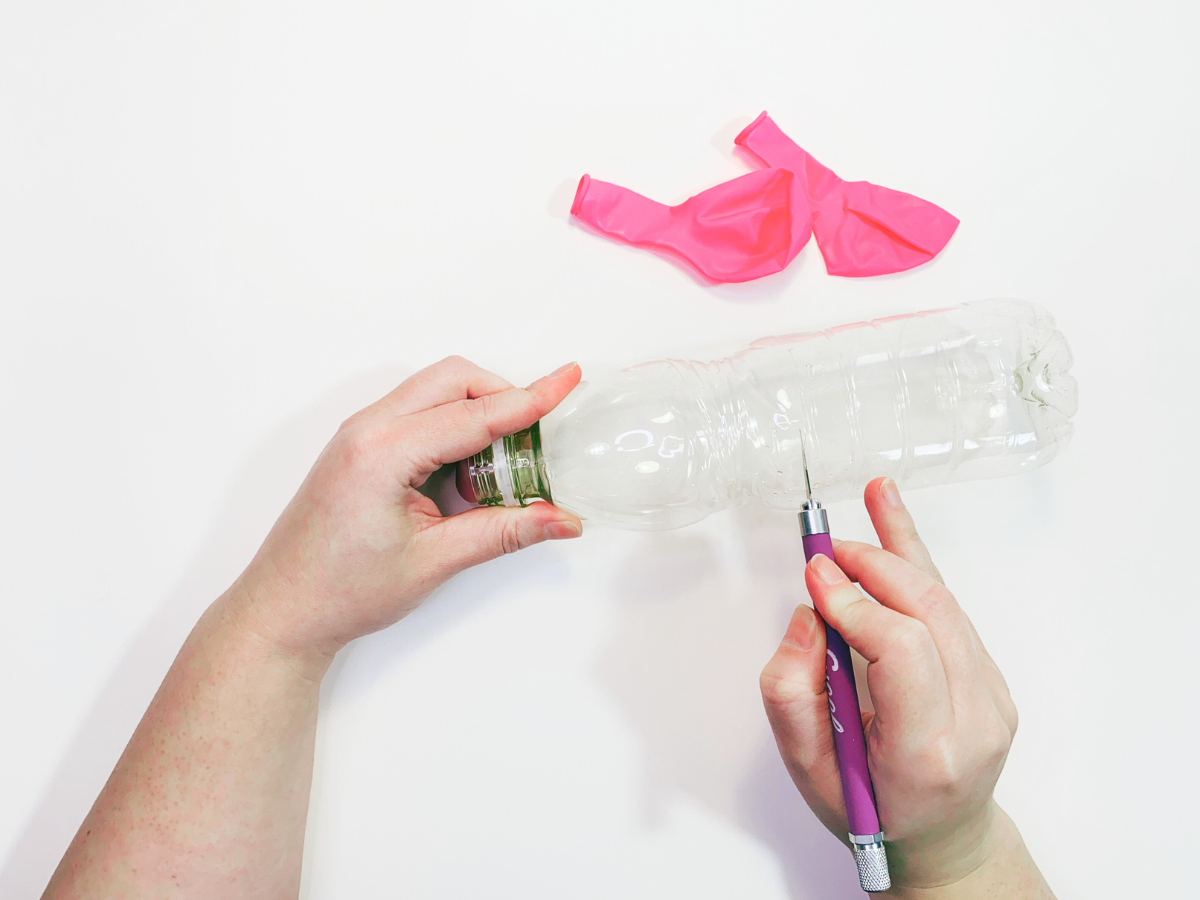

Step 1
Remove the lid and cut the bottom off the plastic bottle.
This bottle will be the ribcage.

Slide 8
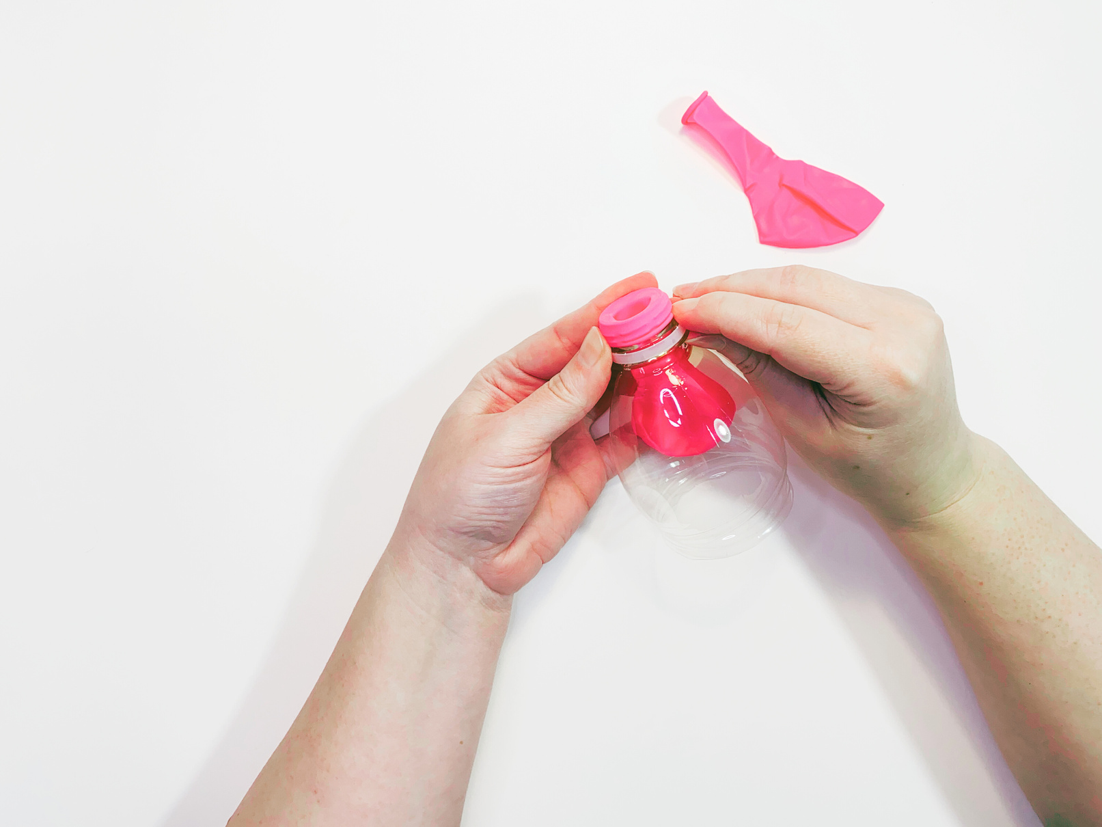

Step 2
Hang one balloon inside the top of the plastic bottle and stretch the neck of the balloon over the neck of the bottle.
This balloon represents the bag-like lungs.

Slide 9
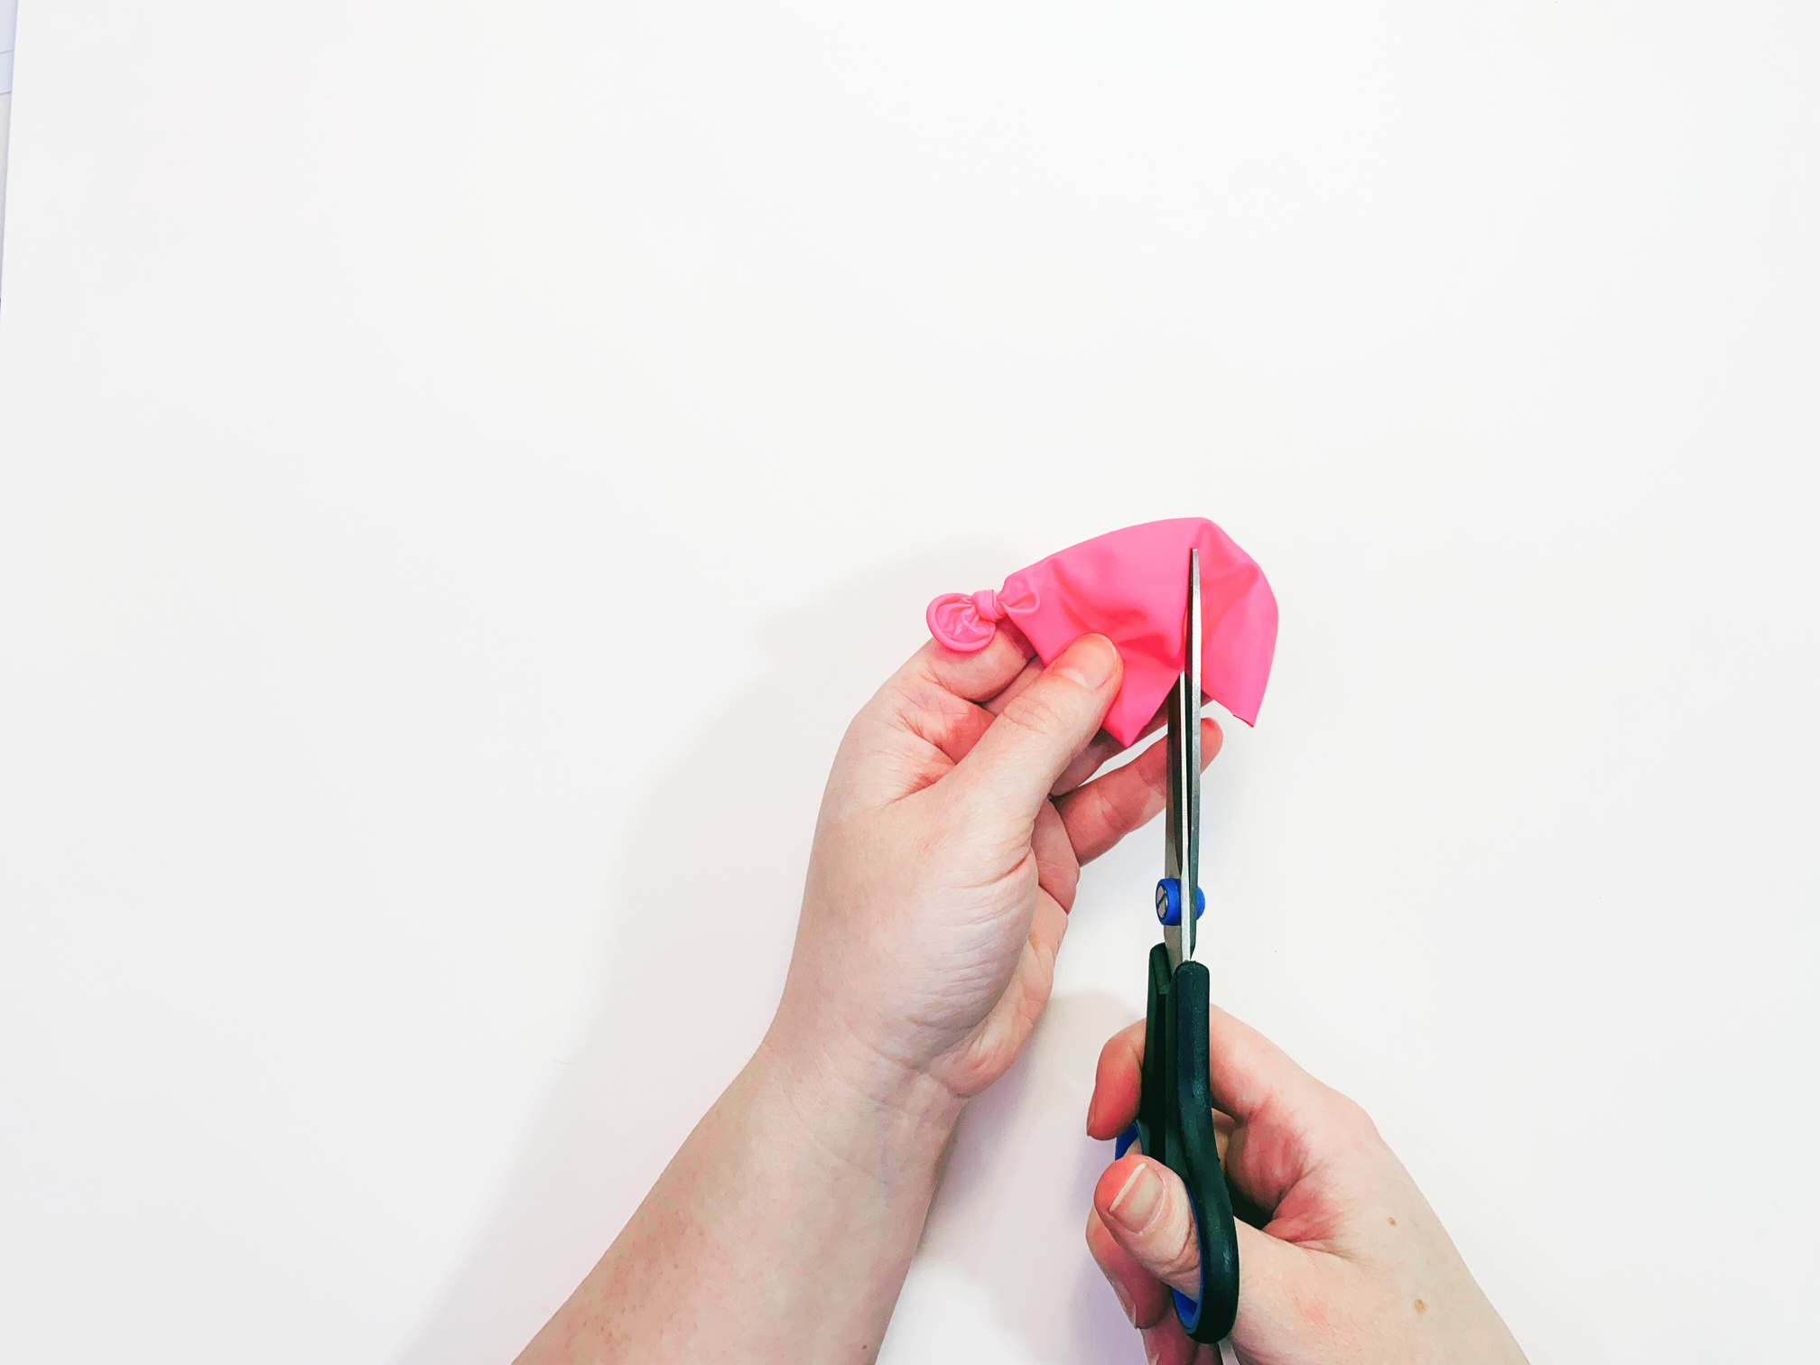
Step 3
Cut off the top third of the second balloon.
Make a knot in the neck of this balloon.

Slide 10
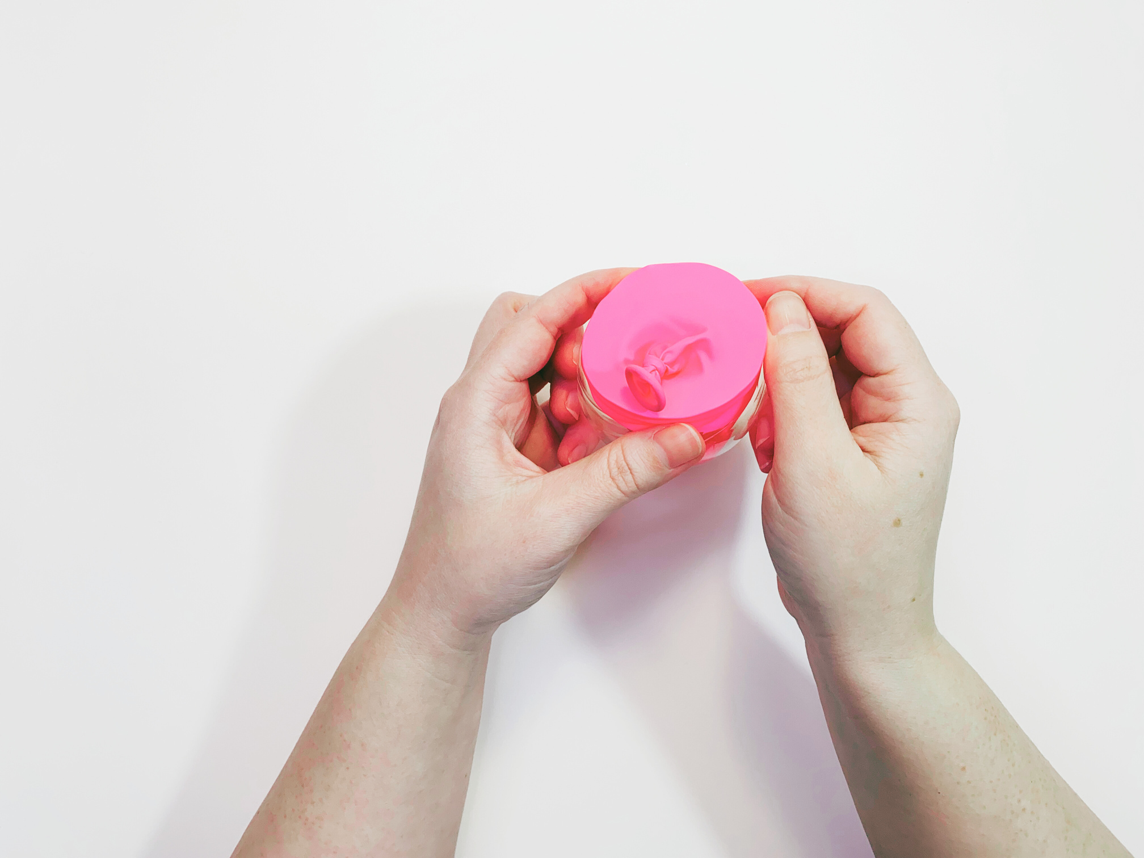
Step 4
Stretch the large, open end of this balloon over the wide opening at the bottom of the bottle.
This balloon at the bottom of the bottle is like the diaphragm.

Slide 11
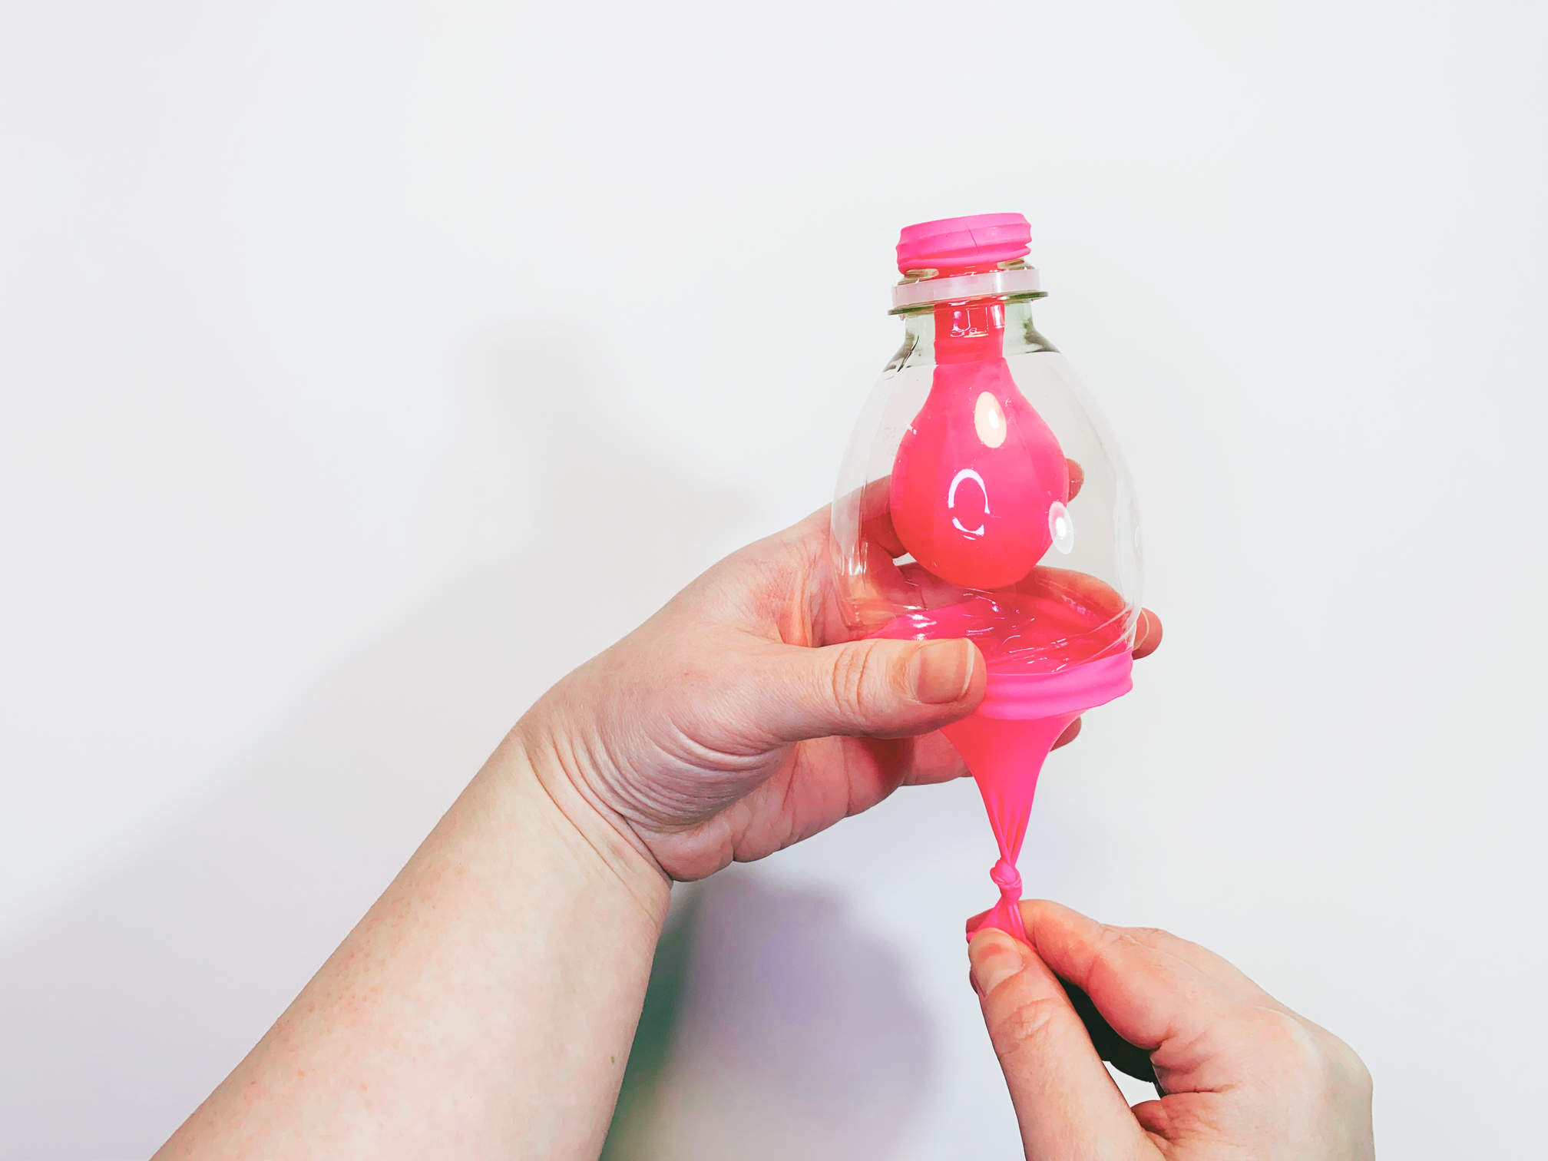
Step 5
Holding the bottom balloon in place, gently pull the knotted end down, away from the bottle.
As you pull this balloon down, the other balloon, hanging from the neck of the bottle, will fill with air.
When you gently release the knot, the balloon at the top of the bottle will empty of air.

Slide 12
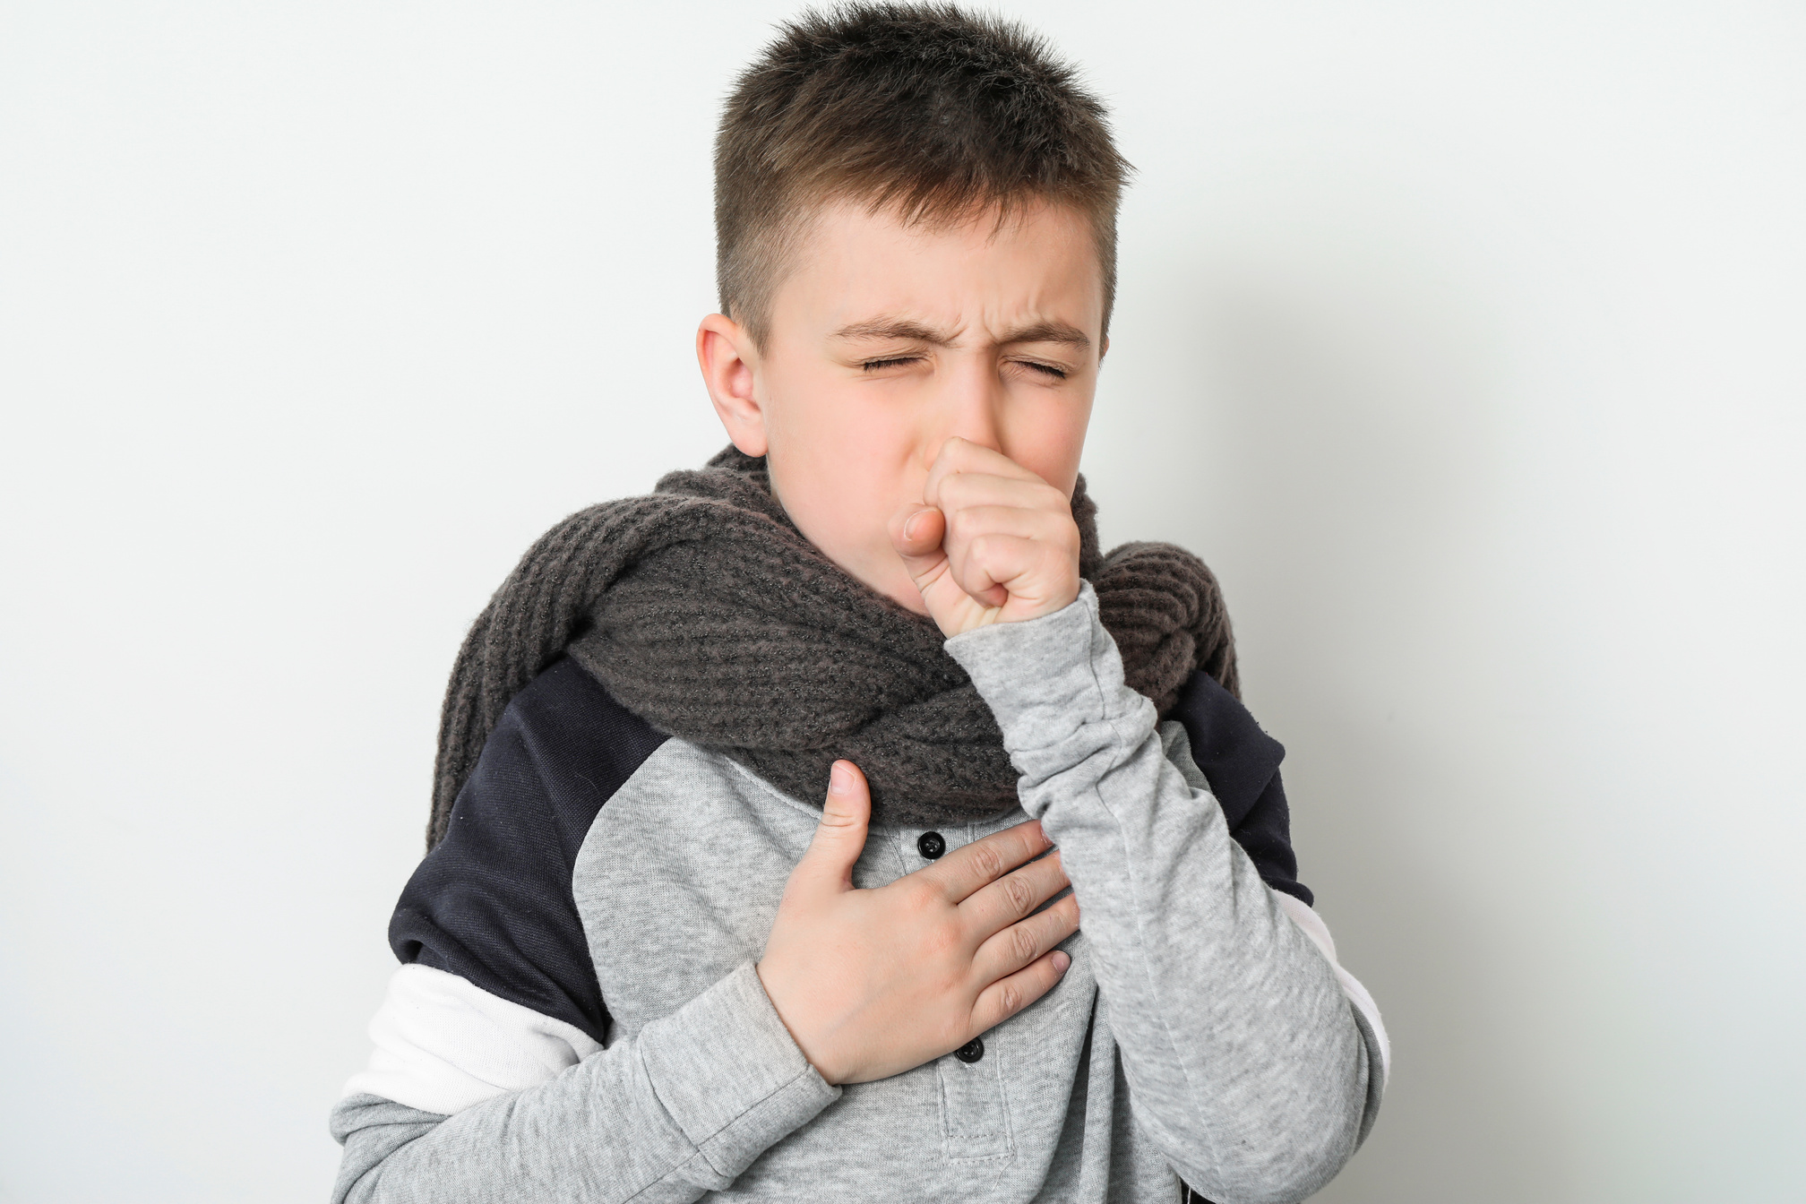
Hard-working lungs
The lungs have the important job of supporting gas exchange. They deliver oxygen to our blood and extract carbon dioxide from our blood.
They also trap and get rid of harmful substances from the air. They do this by trapping things like bacteria and pollution in the sticky mucus that lines our lungs.
The mucus, along with the harmful substances, leave our bodies when we cough.

Slide 13

Healthy lungs
Can you think of some ways we keep our bodies healthy?
Just like other parts of our body, it's important to look after our lungs.
There are lots of ways to do this and you're probably doing some of them already!

Slide 14
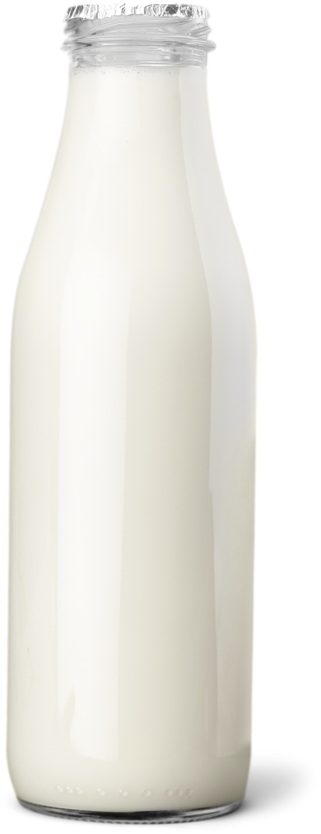
Lung capacity
Exercise helps your lungs to improve their capacity (that means how much air they can hold).
You might be surprised to learn that we breathe in around 13 pints of air every minute!

Slide 15
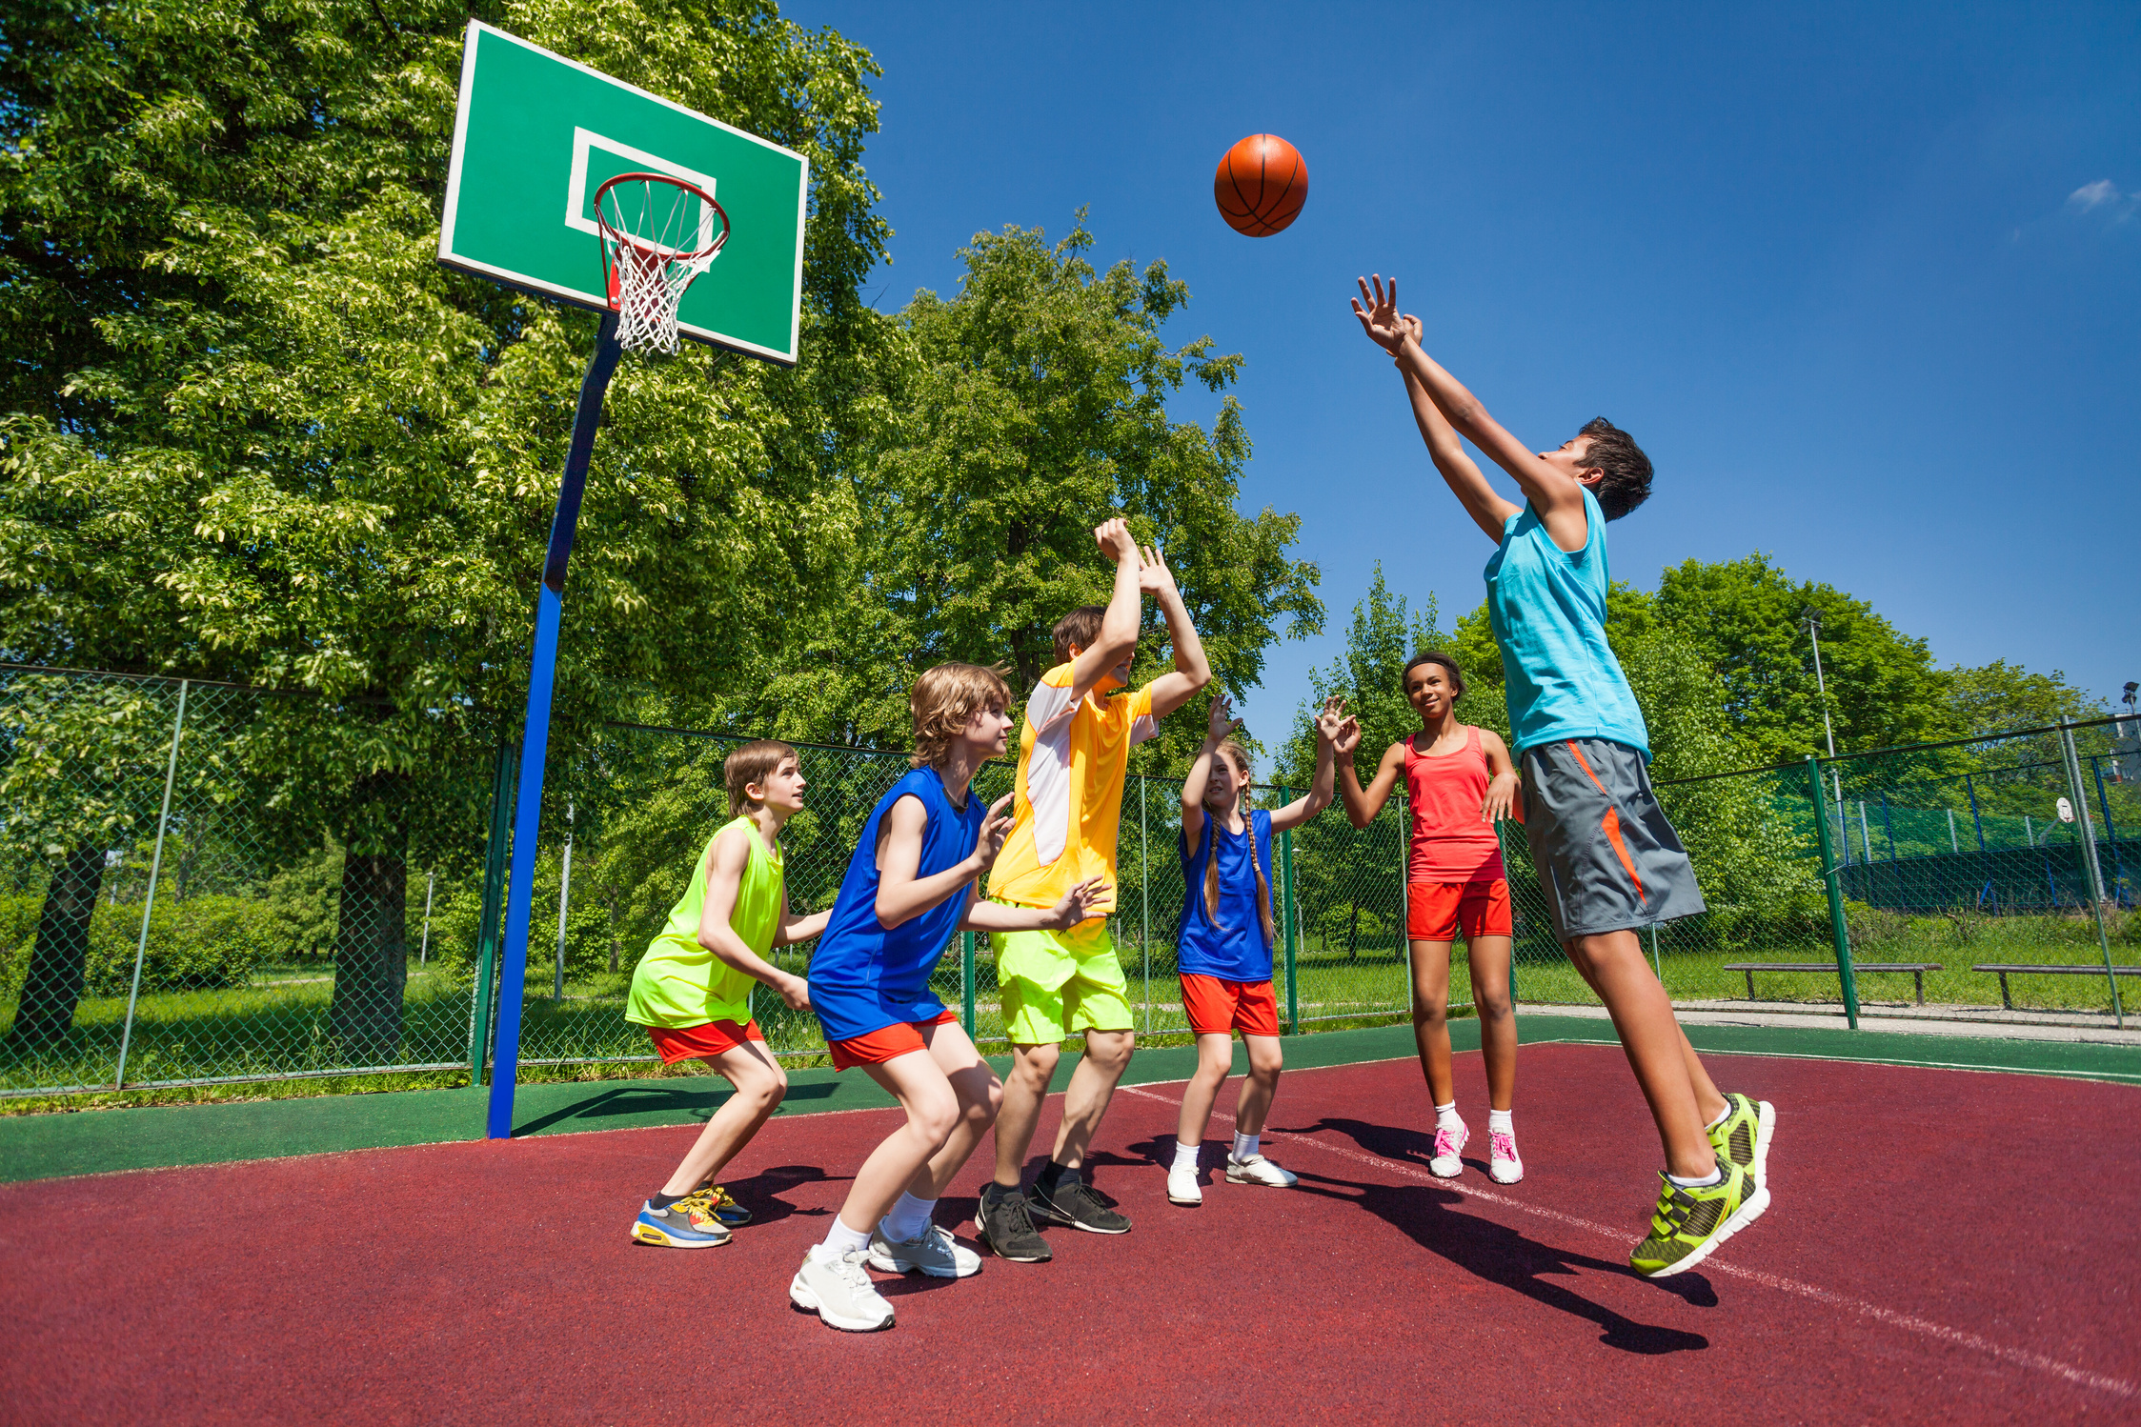
Get moving!
When we are physically active, our lungs have to work harder.
You might be bouncing on a trampoline, walking the dog, climbing in the park, or swimming at the local pool.
Whatever you do to exercise your body is great for your lungs!

Slide 16
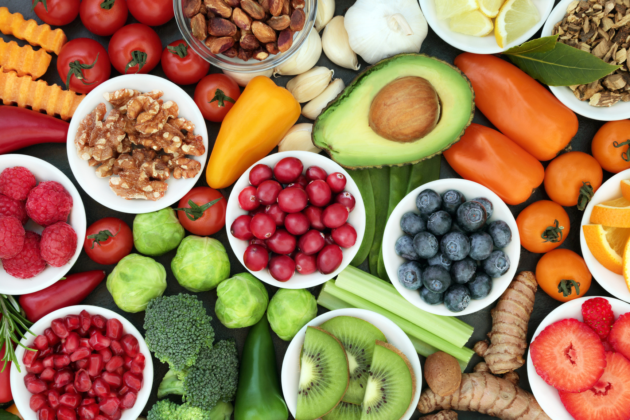
Healthy eating
You probably already know that eating healthy foods and staying hydrated is good for our bodies and minds.
Eating healthily and drinking water is an important part of good lung health.
•Our bodies need energy from good foods to fuel all the organs (including the lungs).
•Drinking water can help keep the mucus lining in our lungs from becoming too thick.

Slide 17
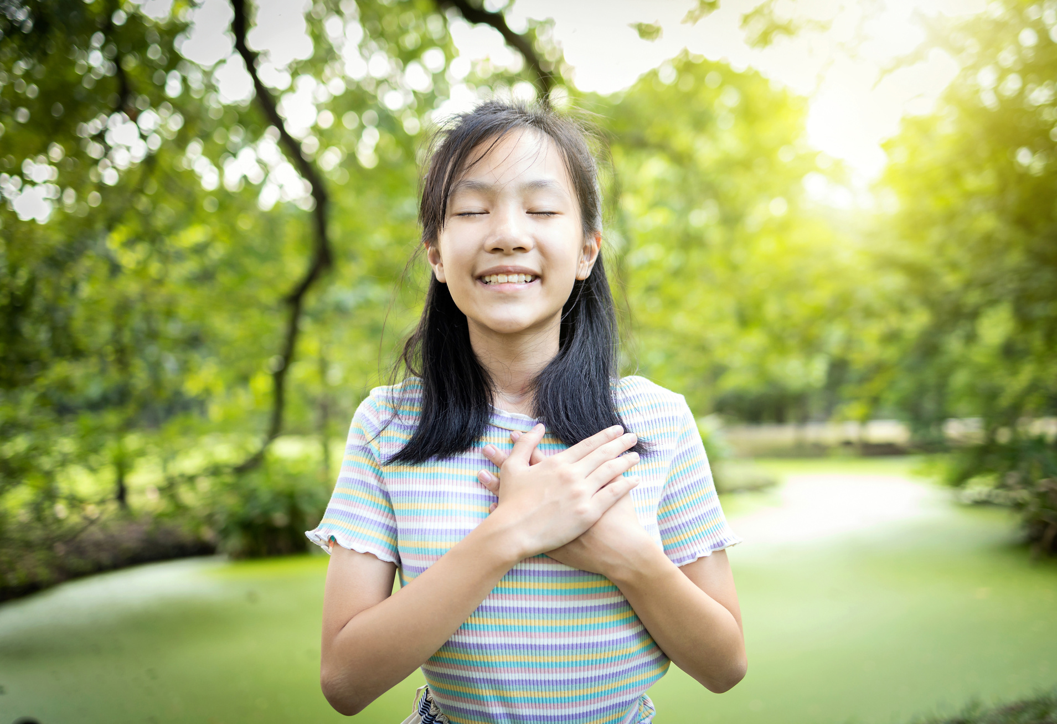
What we inhale
We can also look after our lungs by trying not to breathe in polluted air or harmful substances.
This applies both indoors and outdoors.

Slide 18
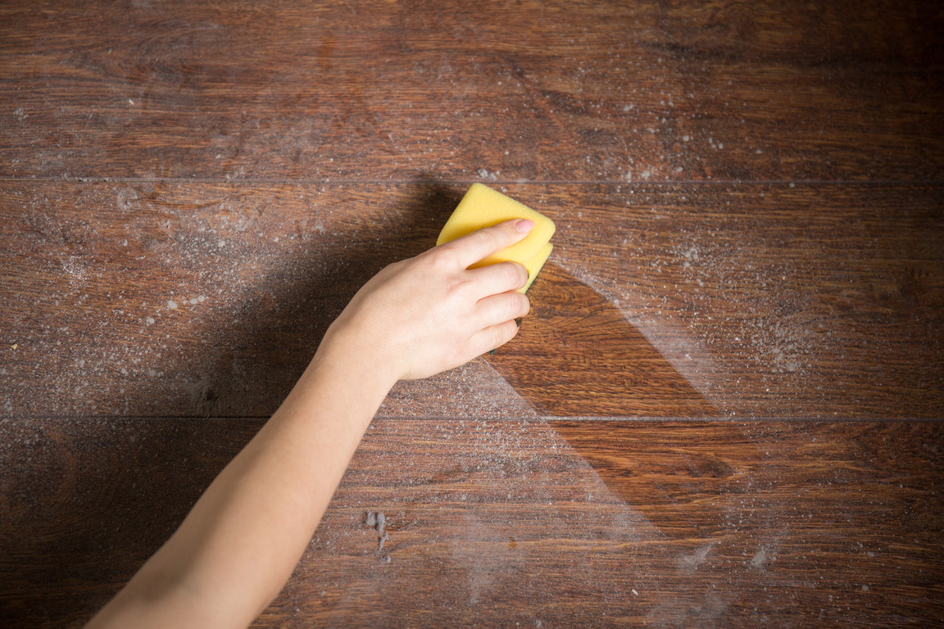
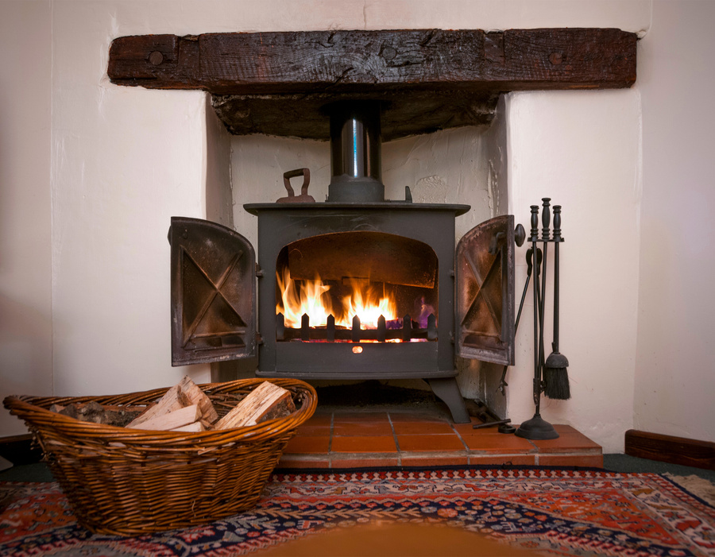
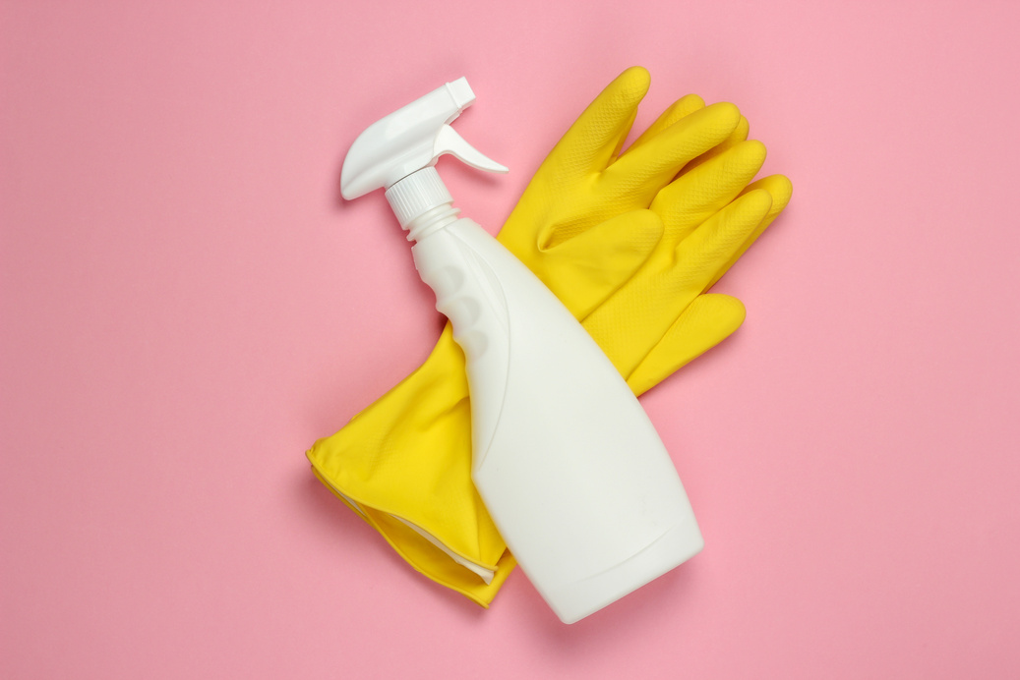
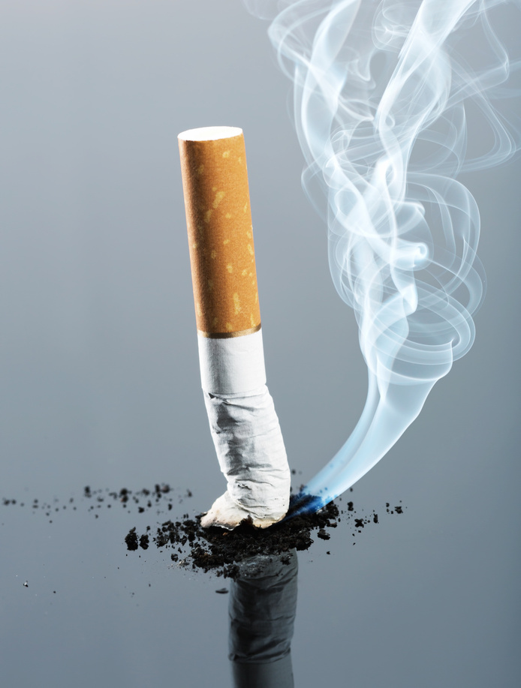
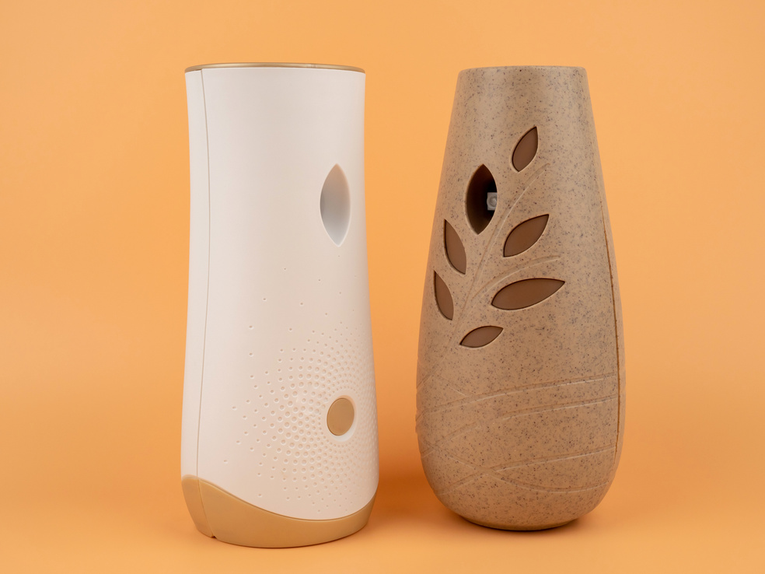



Clean air indoors
Use these pictures to help identify indoor air pollutants and things that could cause breathing problems for some people.
Indoors, we can avoid inhaling cigarette smoke, dust and harmful chemicals, like cleaning products.

Slide 19
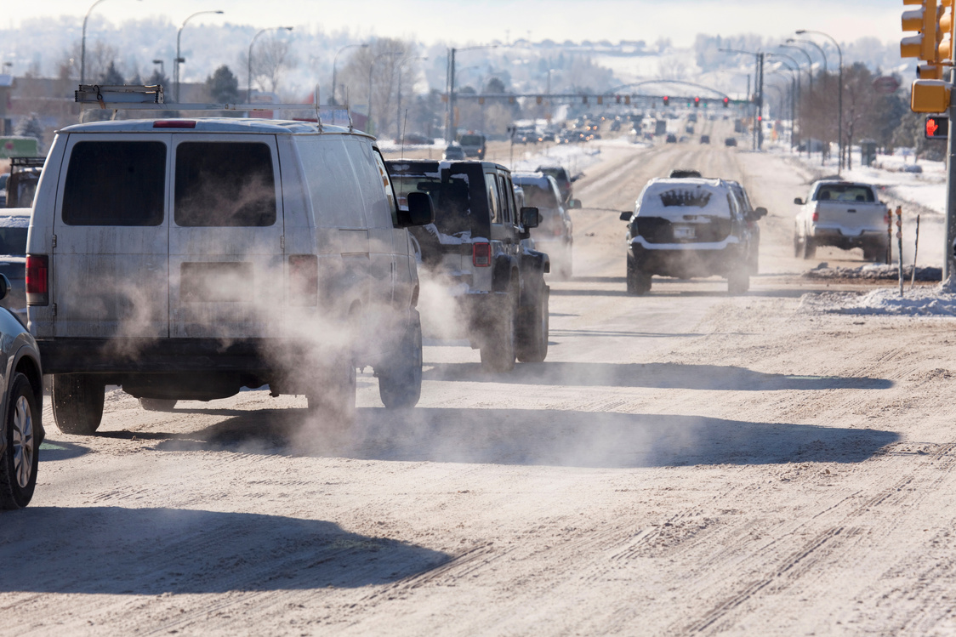
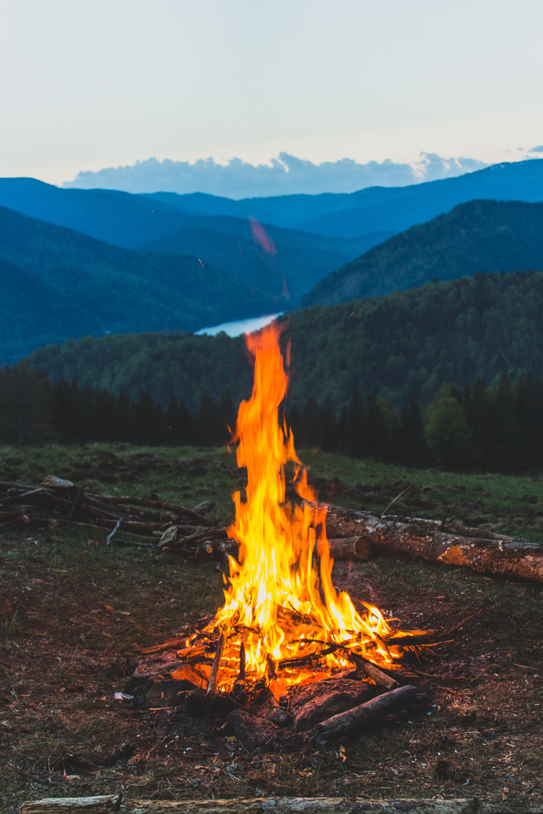
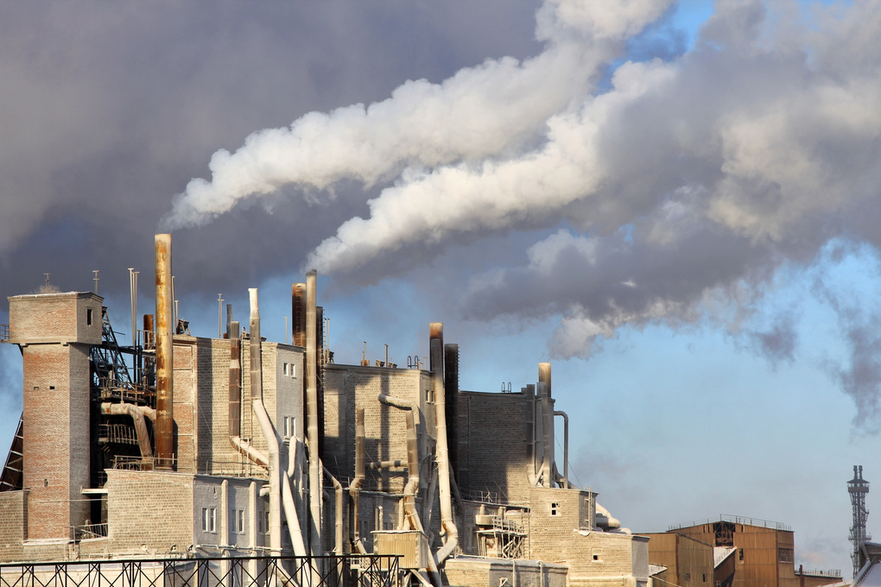
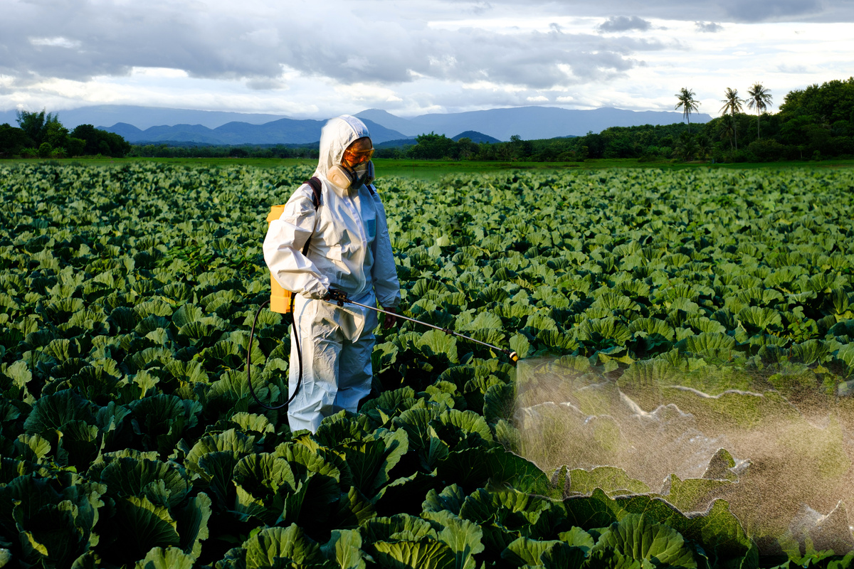
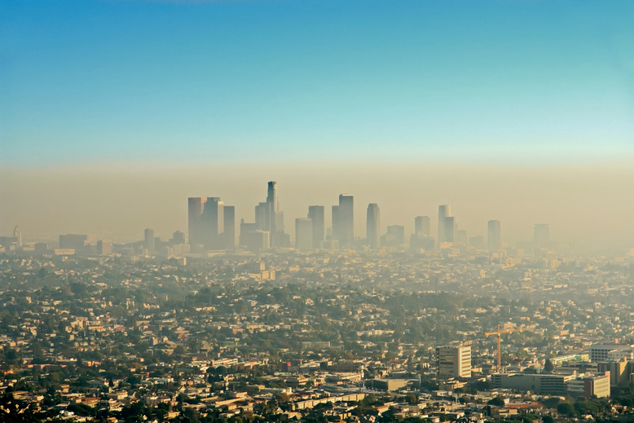
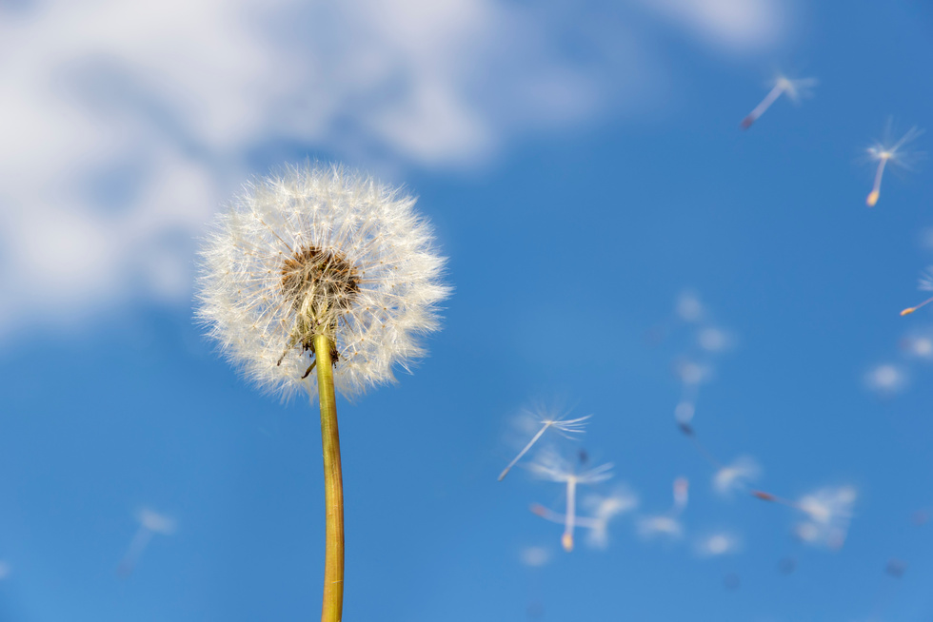
Clean air outdoors
Use these pictures to identify outdoor air pollutants and things that could cause breathing problems for some people.
Outside, we can avoid breathing in pollutants such as fumes from vehicles and smoke from factories.

Slide 20

Pollen pollutants
People who are allergic to pollens in the air may have symptoms such as itchy eyes, a runny or blocked nose and coughing.
The pollen irritates the airways. If our nose is blocked, we breathe through our mouth which allows more pollen to reach our lungs.
However, with the right treatment, people can stay on top of these symptoms and enjoy life to the full.
Do you know anyone who is allergic to pollen?

Slide 21

Super lungs!
Just as we can strengthen the muscles in our arms and legs, we can strengthen the muscles around our lungs.
The intercostal muscles are responsible for spreading and lifting your diaphragm and ribcage.
Blowing up balloons is a great exercise to improve lung capacity.
Let's all try now.

Slide 22
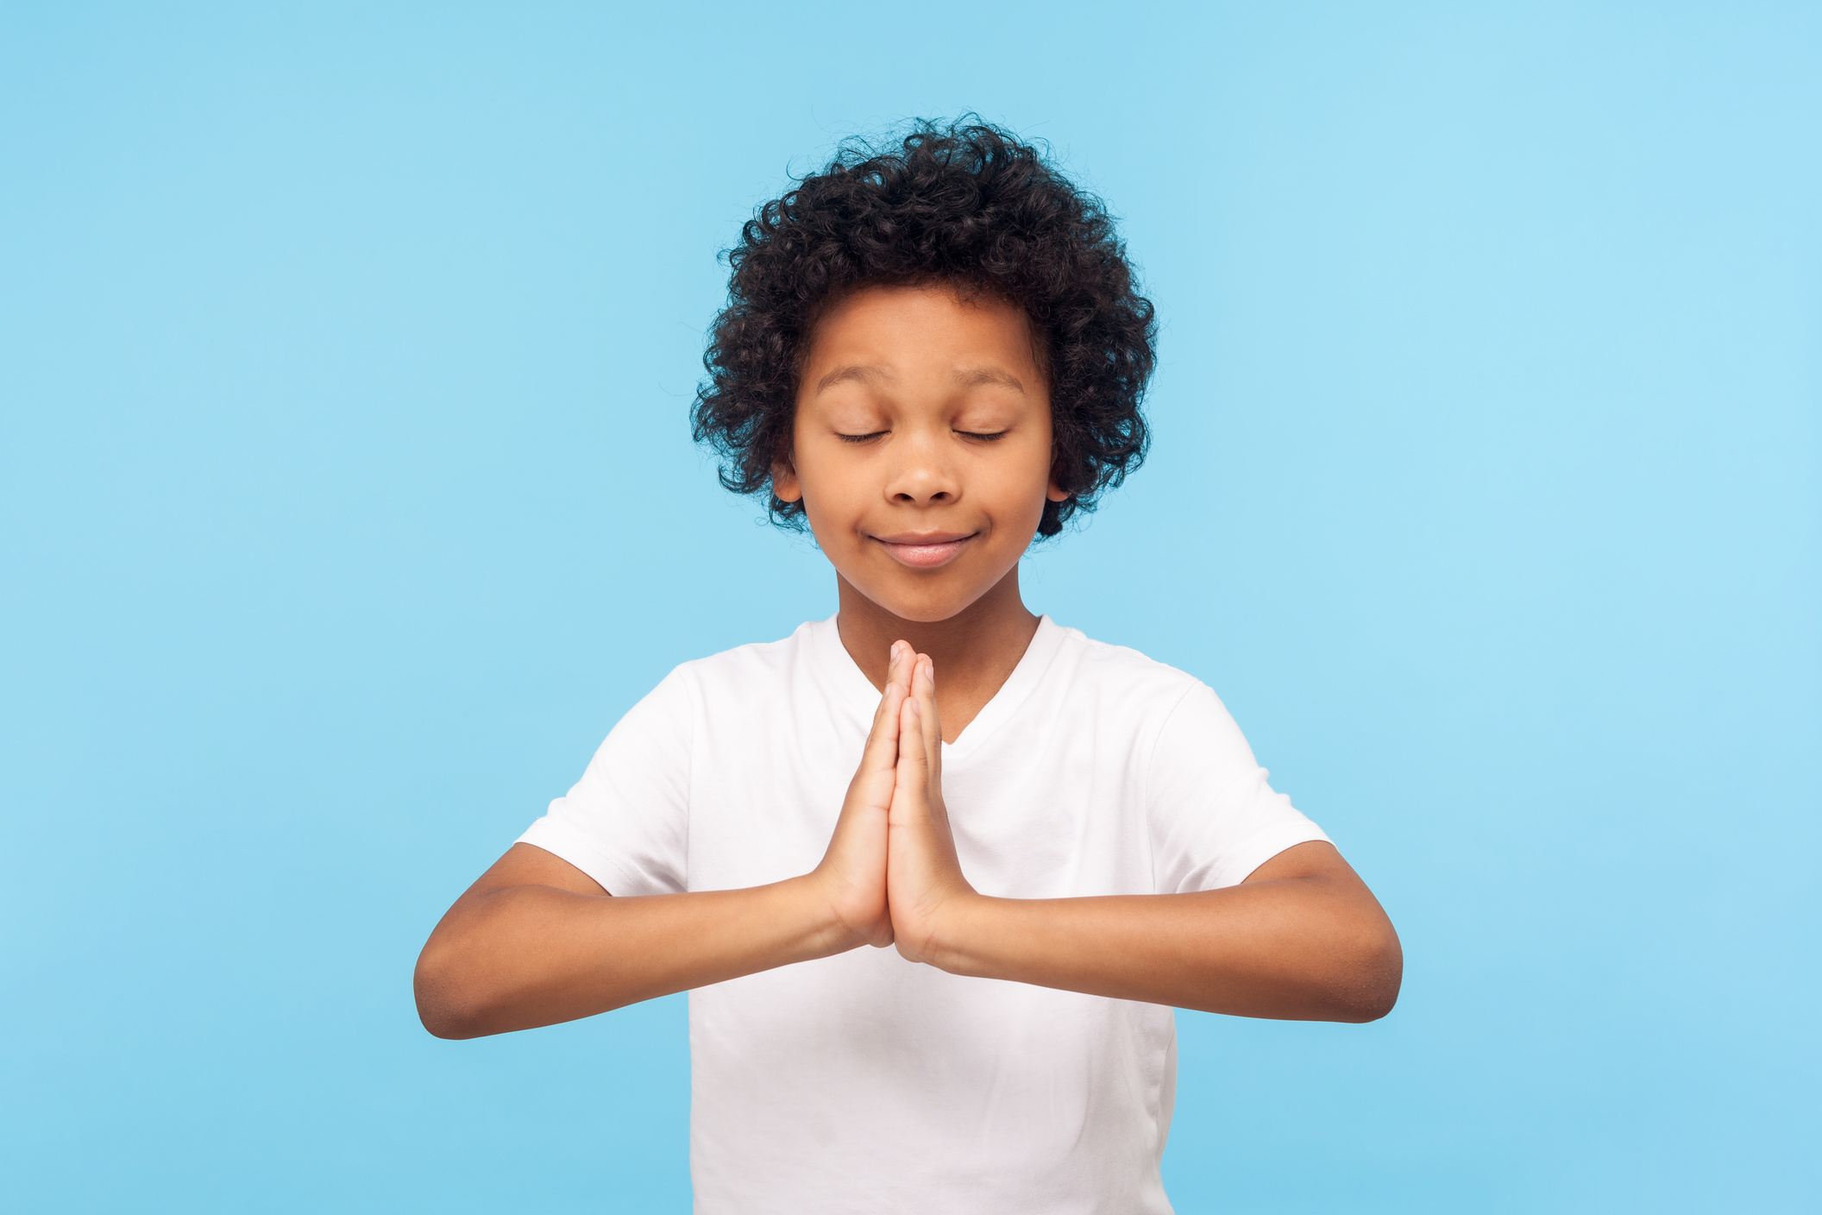
The power of
breathing
Breathing keeps our bodies healthy, as it draws in oxygen and gets rid of carbon dioxide.
But did you know that breathing can also help our mental wellbeing? That means it can help us with our feelings and emotions.

Slide 23

A breathing exercise to try
To end our lesson today, let's try a breathing exercise that's great for when you're feeling stressed, anxious or frustrated.
It's called belly breathing. You can do it either sitting or lying down with your knees up. You might like to close your eyes, but you don't have to.
•Place one hand on your tummy and the other on your chest.
•Take a slow, deep breath in through your nose until you feel your lungs fully inflate.
•Exhale out of your mouth.
•With each breath, ensure your stomach rises on the inhale and falls on the exhale.

Slide 24
What have we learnt today?
1. Can you explain to your partner what our lungs do?
2. Can you remember two things that can cause problems with our breathing?
3. Can you name three ways we can look after our lungs?

Slide 25
Breath is an inhalation, an exhalation. Breath is life.
We’re the UK’s lung health charity, fighting for your right to breathe.

